Slide 1
Modelling in Systems development
A means to
handle complexity
Abstraction
Simplification
Communicate with
users
what do you want?
your self (over time)
what did I have in mind?
what have I created?
other developers
what knowledge and which ideas do we share?

Slide 2


Point of view
Makes sense to apply several models of the same object.
Different models can illustrate various aspects.

Slide 3
Muliple models – has an advantage
Provides:
representation of more aspects of the system (i.e: structure , dynamical behaviour)
a separation of the analysis of the problem (what) from the construction of the systemet (how)
The final system is
created through the use of temporary models
documented with a set of final models

Slide 4
Basic UML diagram types
Class Diagram structure
Sequence Diagram behaviour
Activity Diagram behaviour
State diagram behaviour

Slide 5
Specific UML models for various purposes
Analysis - gain knowledge
Domain Model – UML Class diagram
Business process model – UML Activity diagram
Specification - evaluate ideas and communicate decisions
Design Class Diagram – UML Class Diagram
Sequence Diagram – UML Sequence Diagram
Documentation - show views of implementation
Design Class Diagram – UML Class Diagram
Sequence Diagram – UML Sequence Diagram

Slide 6
Domain model – what is it?
A model of the context of the system (a conceptual model)
Shows important types of ”things” and ”events” from within the problem area (the domain) and relations between them
Prepared in co-operation between developers and domain experts
A visual glossary
Notes:
Prøv at lave Glossary

Slide 7
Domain model – purpose
Helps users and developers to reach a common understanding of the context of the system and the relevant terminology
Serve as inspiration to the design of the system (domain layer)

Slide 8
UML class diagram - modeling the business domain
Object
Class
Association
Generalization
Association Class
…

Slide 9
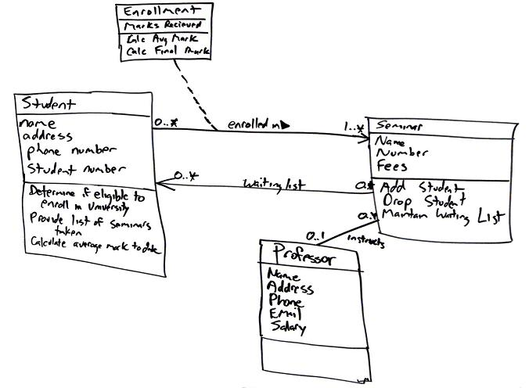
Figure 1. Sketch of a conceptual class diagram.

Slide 10
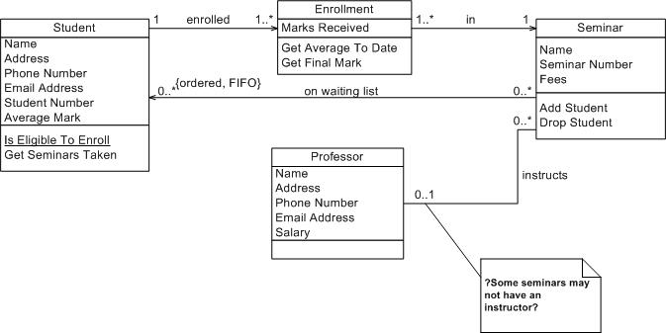
Figure 2. Initial conceptual class diagram.

Slide 11
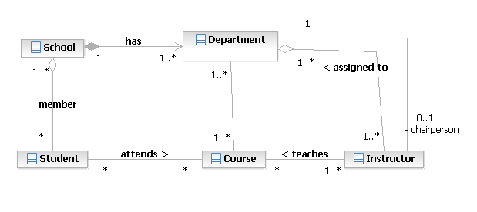
Domain of a school
(From: Booch: The Unified Modeling Language User Guide, fig 5-10)

Slide 12
Domain of what ?
(From Larman: Applying UML and Patterns, fig 9.2)

Slide 13
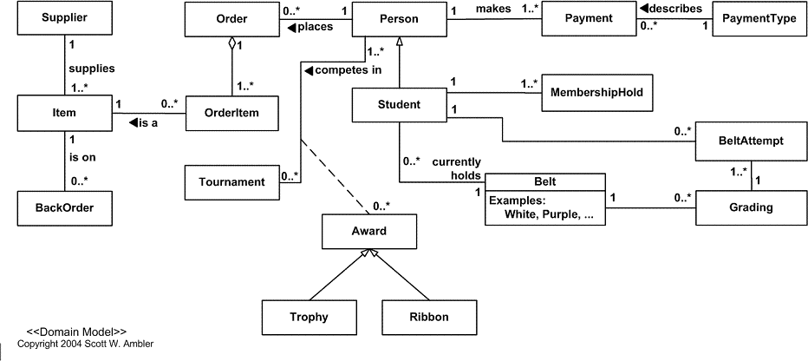
Figure 1. The initial domain model.

Slide 14
Design Class Diagram – what is it?
A model of the structure of the Java program
Focus on static aspects
Shows Java classes and their relationships
A blueprint of the program
Depending on use
All classes
level of detail (attributes, methods, types …)
Notes:
Prøv at lave Glossary

Slide 15
DCD - purpose
Convey ideas about program design
For evaluation
Specify it
For implementation
Document it
For maintenance and extension
Provide overview

Slide 16
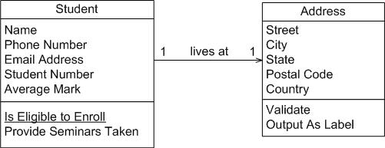
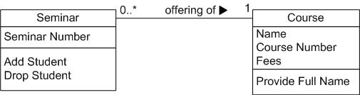
Figure 4. Student and address (Conceptual class diagram).
Figure 5. Seminar normalized (Conceptual class diagram).
Figure 6. Notation for associations.

Slide 17
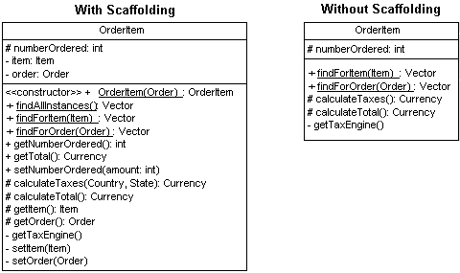
Figure 3. The OrderItem class with and without scaffolding code.

Slide 18
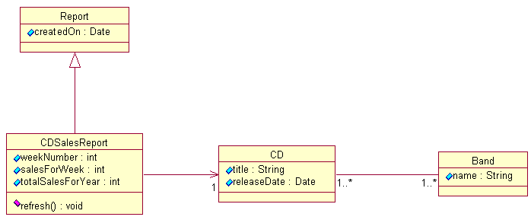
Figure 3: A complete class diagram

Slide 19
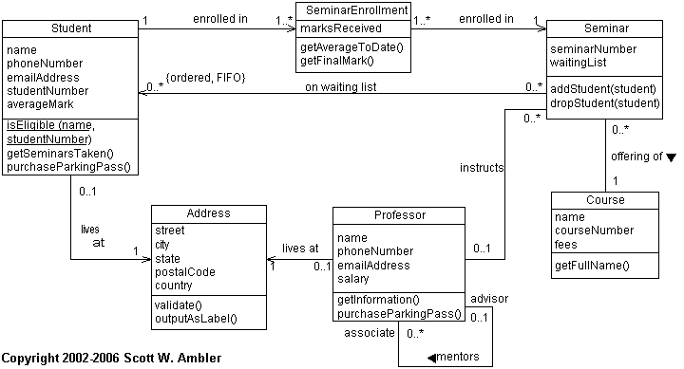
Figure 7. A UML class diagram.

Slide 20
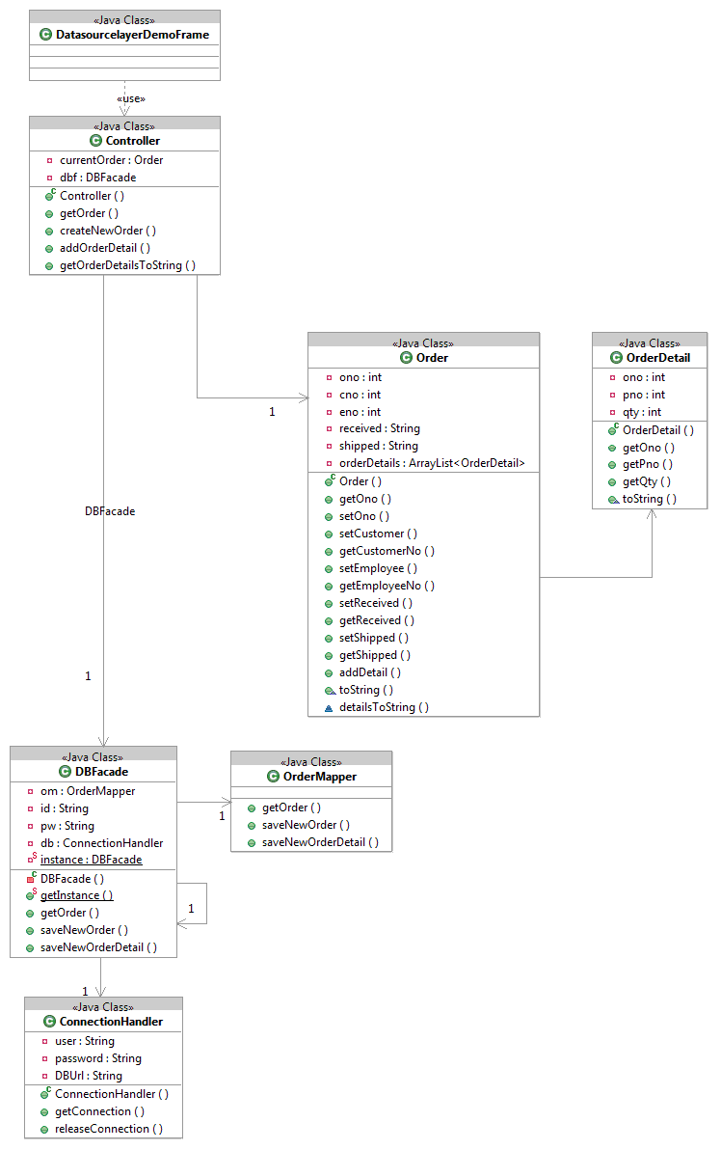
DataSourceLayerDemo

Slide 21
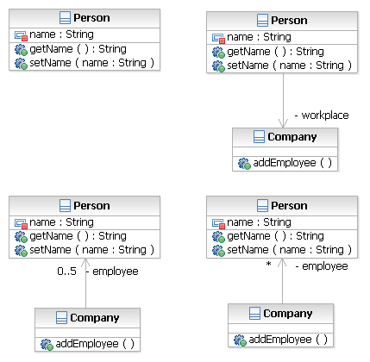
Mapping Java – DCD Class – attribute - method
public class Person
{
private String name;
public String getName ()
{…}
public void setName(String name)
{…}
}
DCD

Slide 22
Association
DCD
public class Person
{
private String name;
private Company workplace;
public String getName ()
{…}
public void setName(String name)
{…}
}
public class Company
{
}

Slide 23
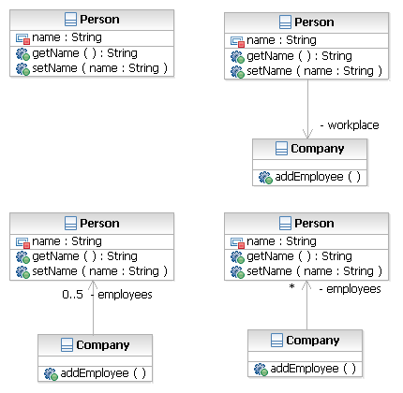
1 to many association /1
public class Person
{
private String name;
public String getName ()
{…}
public void setName(String name)
{…}
}
public class Company
{
private Person[] employees;
public Company()
{
employees = new Person[5];
}
Public void addEmployee()
{}
}
DCD

Slide 24
1 to many association /2
public class Person
{
private String name;
public String getName ()
{…}
public void setName(String name)
{…}
}
public class Company
{
private ArrayList<Person> employees;
public Company()
{
employees =
new ArrayList<Person>();
}
}
DCD

Slide 25
UML Sequence Diagram – what?
A model of the inner behaviour of the Java program
Focus on the dynamic aspects
A graphical representation of how objects co-operate by calling methods on each other

Slide 26
UML Sequence Diagram – why?
A tool during design
express ideas about how functionality might be realized by co-operating objects
A medium after coding
documents the actual implementation
typically made for complex or central scenarios only

Slide 27
Fig. 15.7
box, lifeline, object , class
method invocation
flow of control

Slide 28
Fig. 15.8
2 ways to show what is returned (”return”)

Slide 29
Fig. 15.10
Creation of an object (”new”)
parameters

Slide 30
Conditional method invocation (“if”)

Slide 31
Conditional method invocation – (“if - else”)

Slide 32
loop (”while, for …”)

Slide 33
Fig. 15.16
Loop that ”runs through” an array of objects and invoces the same method in each object
Each object is represented (”in turn”) by the shown box

Slide 34
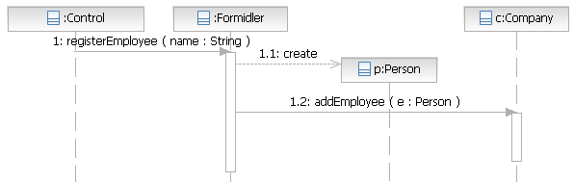
Mapping: Java - SD
SD
public void registerEmployee(String name)
{
Person p = new Person(name);
c.addEmployee(p);
}

Slide 35
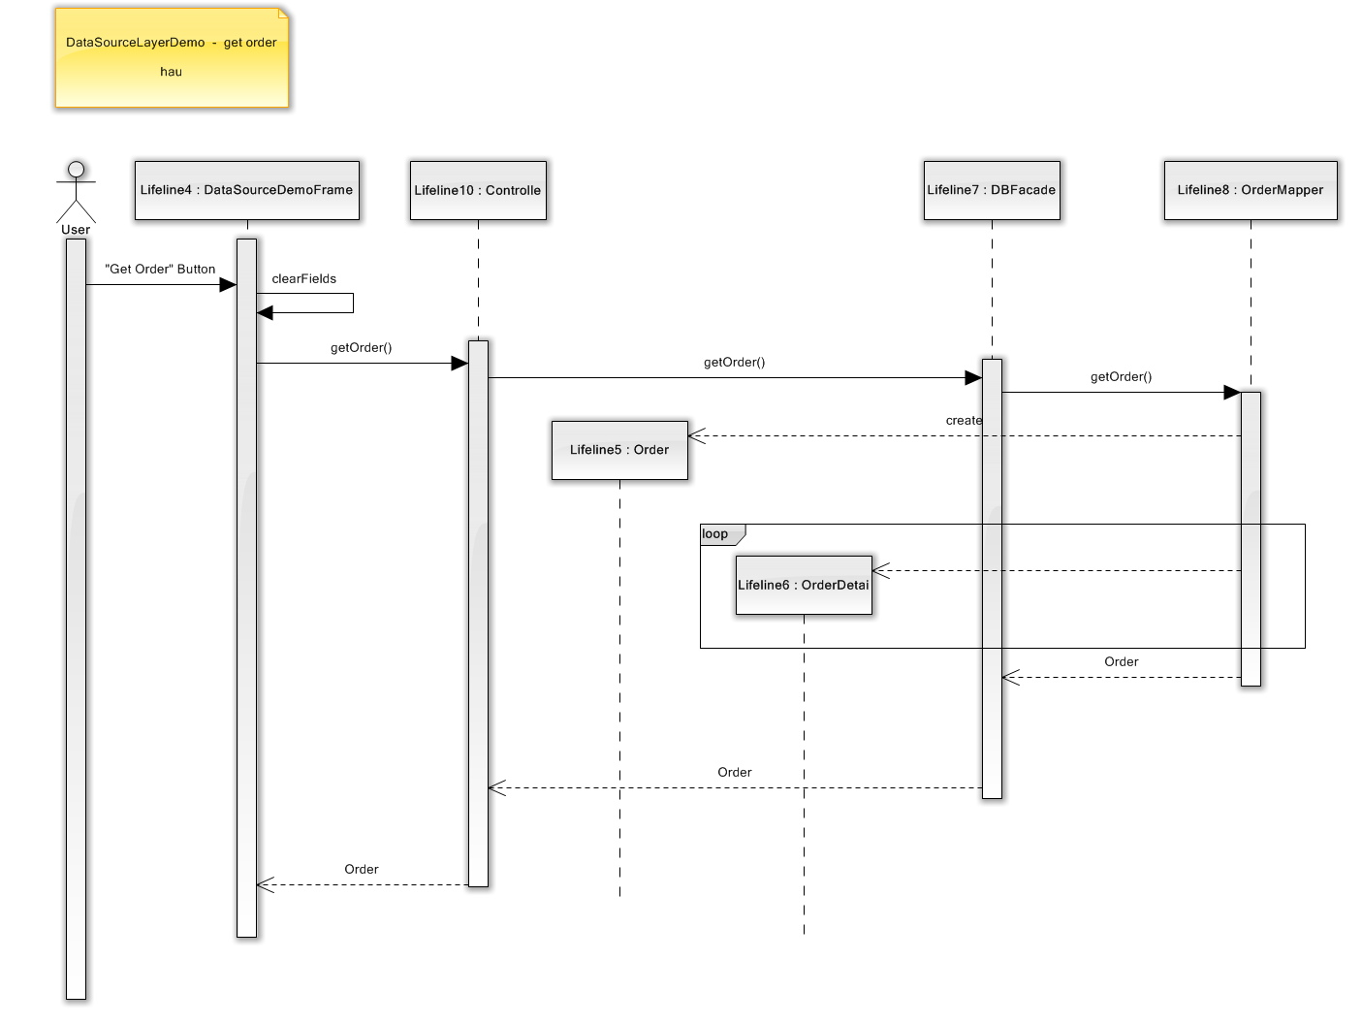

Slide 36
Activity Diagram – what/why?
A model of a process or workflow
Focus on dynamical aspects
Visualize internal procedures in organizations
Shows
sequential rules – allow parallel action
Who does what
May show actions supported by the IT system

Slide 37
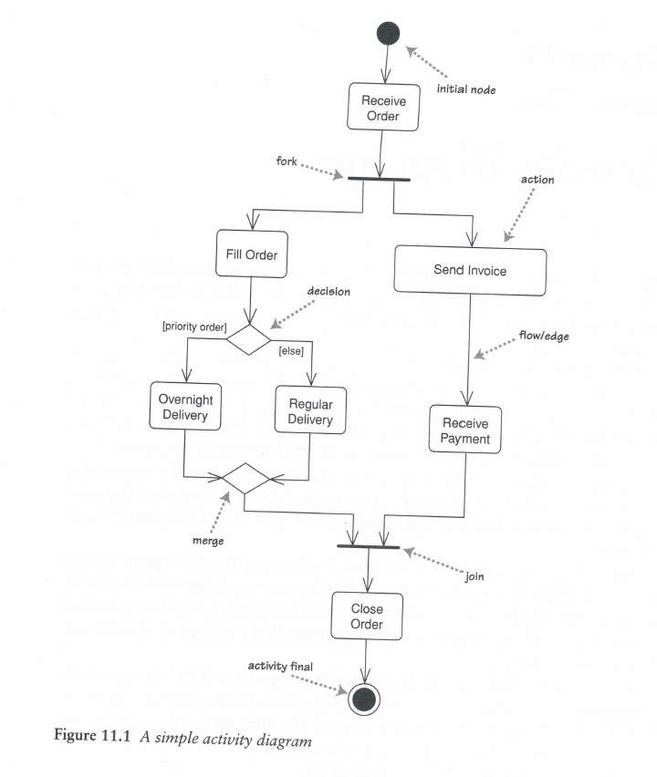

Slide 38
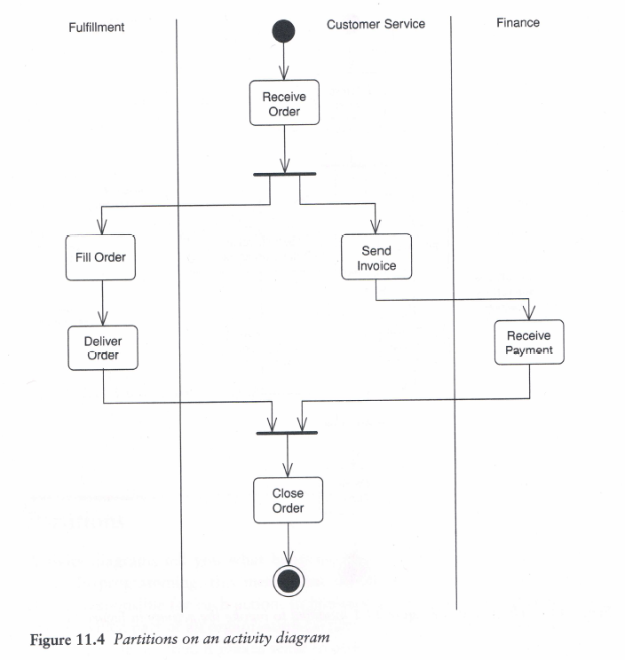

Slide 39
State diagram
Model for behaviour
states, events, state transitions, actions, conditions
Used to
describe complex behaviour
design
planning test
class, subsystem, system

Slide 40
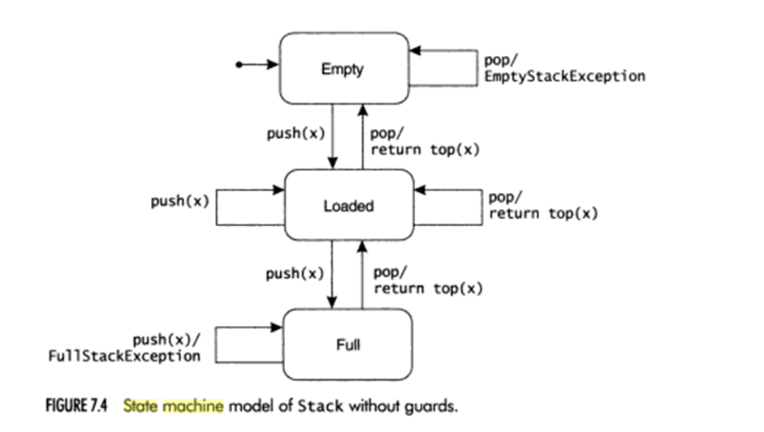
State diagram (without guards)
Ex: stack with limited capacity
Behaviour when ”loaded” is ambiguous.
State
Event
State transition
Action
(Condition/ guard)
Binder: Testing Object-Oriented Systems

Slide 41
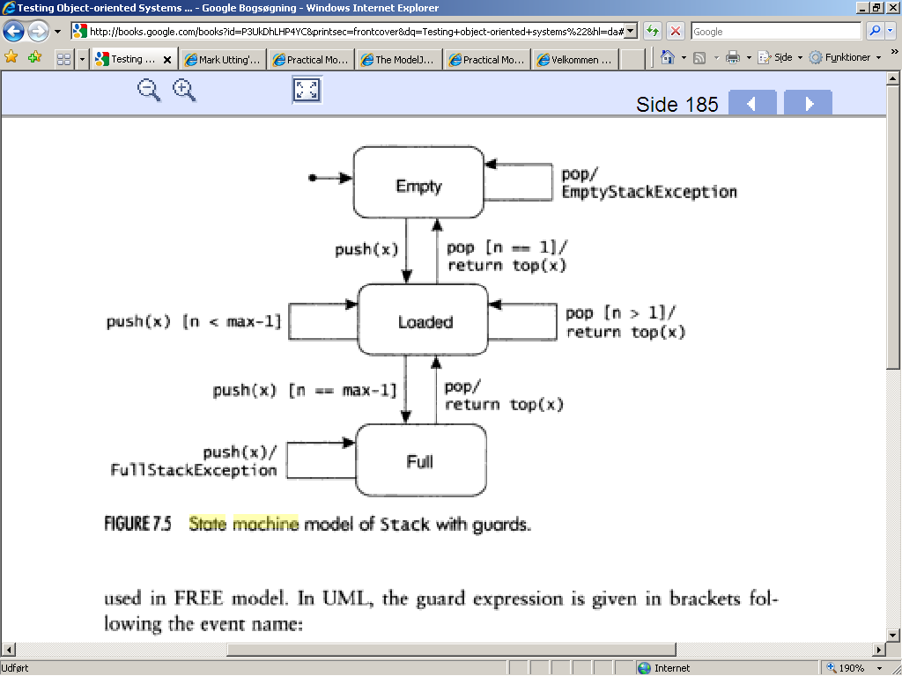
State machine (with guards)

